Slide 1

PROJECT
Feasibility Study of AI Based Smart CMDS
(Counter Measure Dispensing System)
Pari Kashyap
III year, Cse

Slide 2

Organization Details
DRDO (Defence Lab Jodhpur)
DRDO is an organization which deals with Defence Weaponry and Surveillance systems. Working with DRDO is quite adventurous and interesting. It deals with matter of national security. There is plenty of learning opportunities at DRDO labs.
Research and development activities at DRDO cover important demarcated disciplines like aeronautics, rockets and missiles, electronics and instrumentation, combat vehicles, engineering, naval systems, armament technology including explosives research, terrain research, advanced computing, artificial intelligence, robotics, works study, systems analysis and life sciences including high-altitude agriculture, physiology, food technology and nuclear medicine etc.

Slide 3

INTRODUCTION
What is a countermeasure?
An electronic countermeasure (ECM) is an electrical or electronic device designed to trick or deceive radar, sonar, or other detection systems, like infrared (IR) or lasers. It may be used both offensively and defensively to deny targeting information to an enemy.

Slide 4
Types guidance missiles
RF Guidance System
IR Guidance System
The heat is released from the aircraft and detected by the seeker head.
The missile or aircraft transmits a radar wave which reflects off the target, and is detected by the missile seeker.

Slide 5
Types of Countermeasures
Chaff:
Flare:
Engine Exhaust, Aircraft Radar edges and Engine inlets.
IR guided missile.
RF guided missile.
Chaff is used to generate false Radar signature.

Slide 6
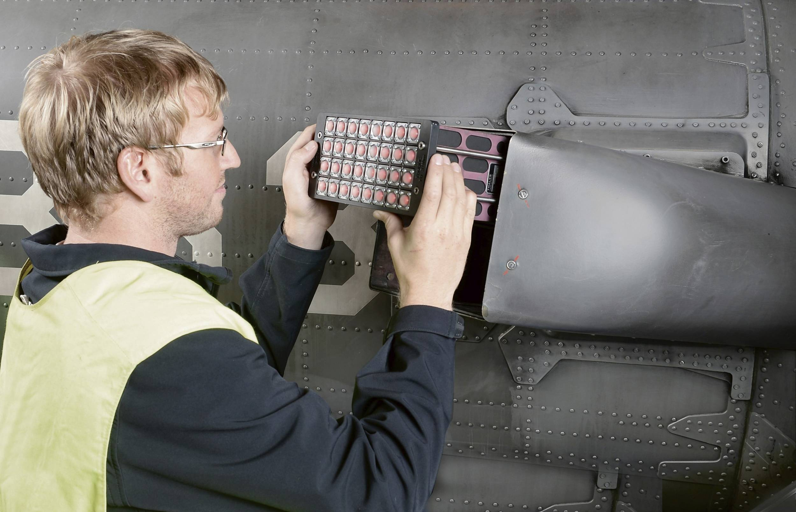
COUNTERMEASURE DISPENSING SYSTEM
CMDS (Counter Measures Dispensing System) is a state-of-the-art Flare and Chaff Dispensing System providing self-protection to the aircraft against Radar guided & IR seeking missiles.

Slide 7
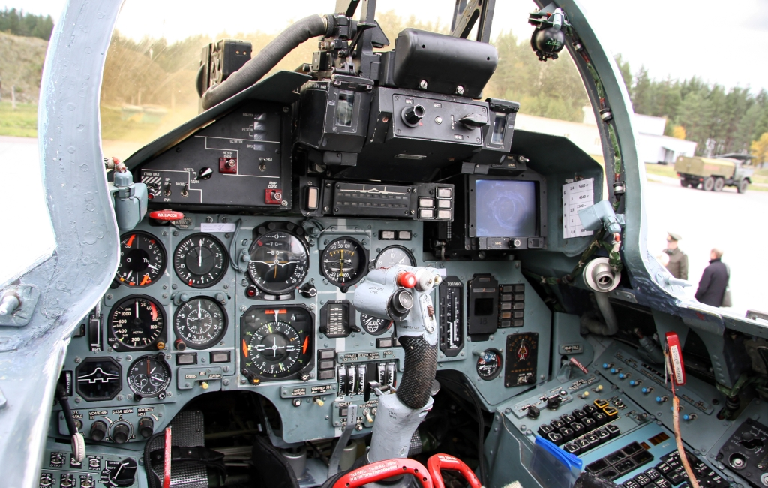
COUNTERMEASURE DISPENSING SYSTEM
The capacity of CMDS is to initially distinguish the approaching rockets and show it in the MFD (Multi-function display) which the pilot can see by sitting in the cockpit.
There are two sorts of rockets: -
IR rockets that takes a shot at the rule of Warmth Detecting.
Radar Looking for Rockets.

Slide 8

ARTIFICIAL INTELLIGENCE
Artificial intelligence is intelligence demonstrated by machines, as opposed to the natural intelligence displayed by animals including humans. It aims to create intelligent machines.
Types of Artificial intelligence used in my project-
Based on Learning:
Supervised Learning
Based on Functionality:
Limited Theory
Based on Capabilities:
Artificial Narrow Intelligence (ANI)

Slide 9


TECHNOLOGY USED
The technologies studied during training are C++, computer graphics and file handling to bring best out of the project, Feasibility Study of AI Based Smart CMDS. And also learned about how to train the program and give the precise output.

Slide 10

Details of PROJECT WORK
Dispensing System for RF Missiles (Chaff Countermeasure)
The main program infinitely runs in listening mode, and as soon as it gets any info from RWR (Radar Warning Receiver), regarding arrival of any threat, it takes the decision as per the training data (AI), to dispense the metallic cloud fibre in the environment and manoeuvre the aircraft according to different locations of the missiles.

Slide 11
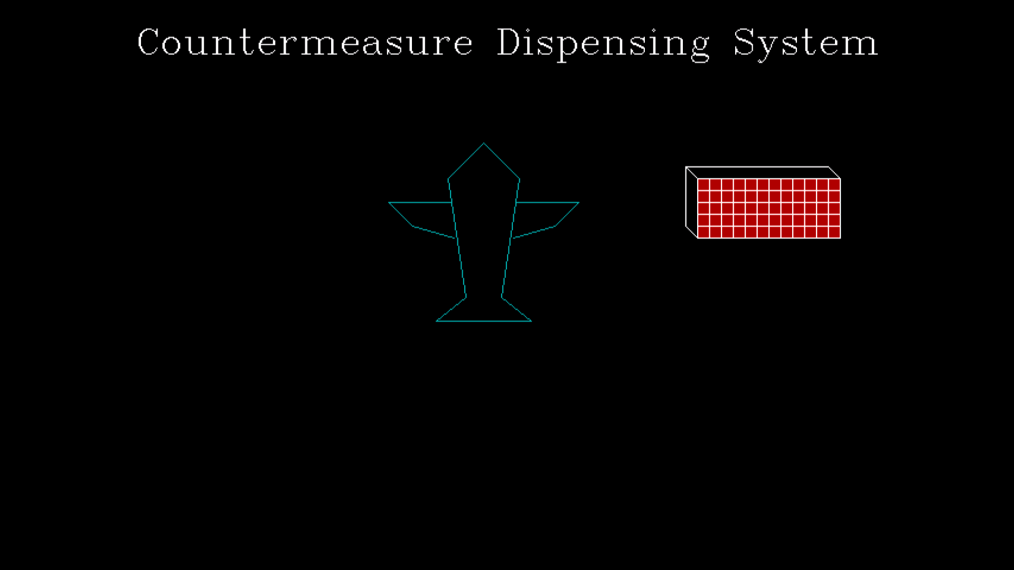
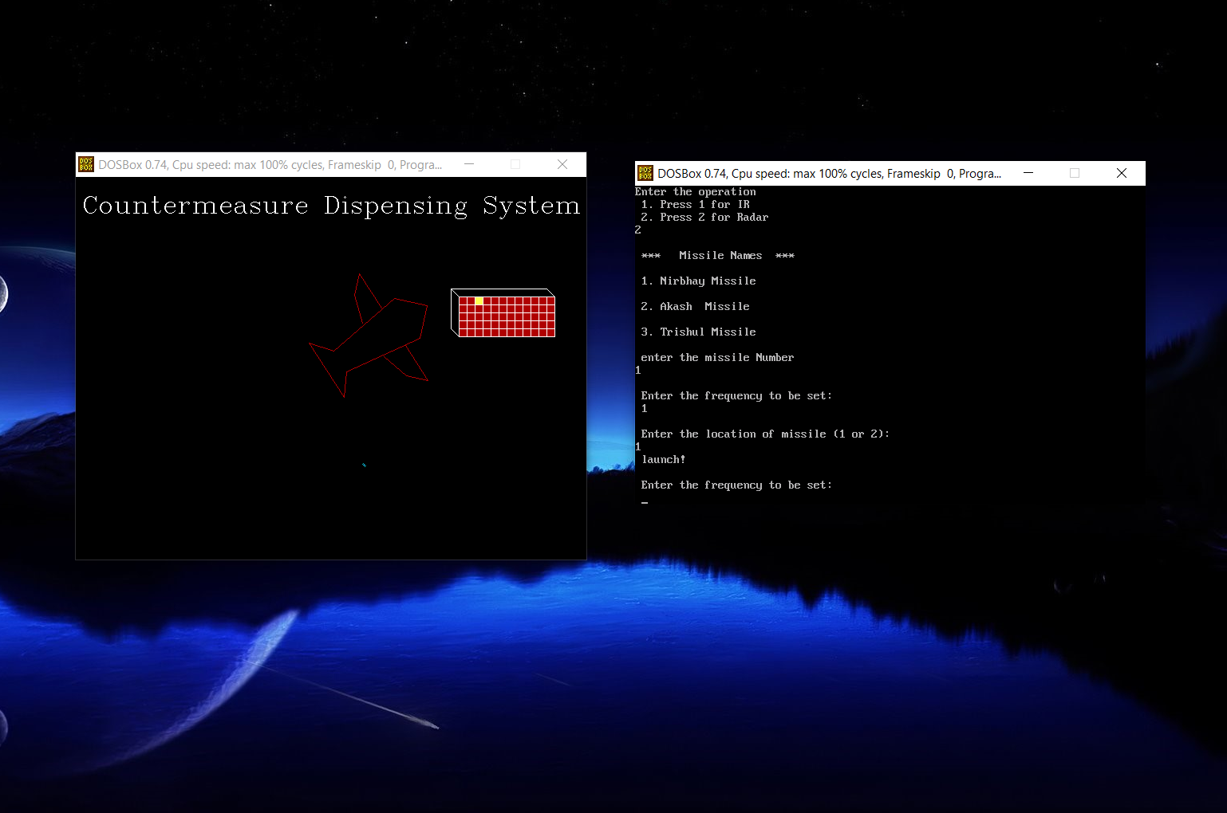
Some images of the project

Slide 12

Some images of the project

Slide 13
Applications and Future Work
Chaff is used worldwide to protect Military Aircrafts and Naval Ships from enemy’s radar and Radar Frequency (RF) missiles. The program developed here will be used for concept building of smart CMDS to be incorporated in various armed forces for safeguarding the human and other assets.
For concept building of this, new era of technology in development of upcoming AI based Smart Counter Measure Dispensing System to reduce human interaction. The above mentioned developed software will be highly utilized in safeguarding the aircraft against various threat without depending on the operator or pilot.

Slide 14

CONCLUSION
The project helped in revealing that missile countermeasures are important for aircraft and naval ships. The study of AI based Countermeasure Dispensing System (CMDS) clearly shows that how we can protect the warrior airplanes from IR and RF guided missiles.

Slide 15
“In the midst of an ordinary training day, I try to remind myself that I am preparing for the extraordinary.”
- Shalane Flanagan

Slide 16


